Slide 1
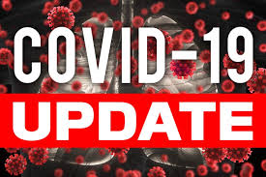
Board of supervisors meeting August 9, 2022

Slide 2
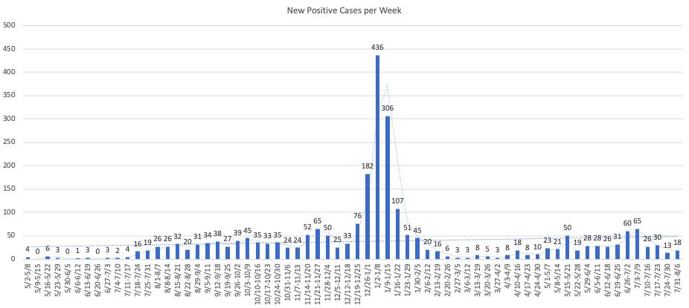
Mono county metrics Tested – 2,553 Negative – 2,347 pending - 125 Positive – 84 deaths - 1 positivity rate – 3.29%
Total positive cases (PCR Conf): 3081 Positivity rate: 16.7%/ Case Rate/100,000: 18.4

Slide 3
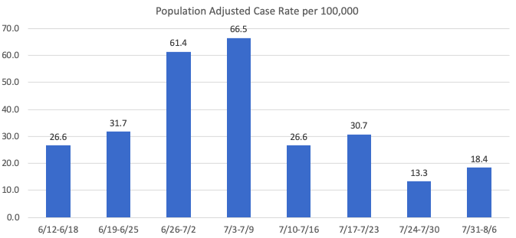
Recent mETrics

Slide 4
Number of POSITIVE cases by week for the past month
7/10 - 7/16: 26
7/17 - 7/23: 30
7/24 - 7/30: 13
7/31 - 8/6: 18

Slide 5
Hospital Status
No current COVID-19 related hospitalizations
Recent brief hospitalizations
Status = Green

Slide 6
Omicron Variants of concern
BA.5 is now the dominant strain accounting for over 75% of cases
BA.4.6 may have a growth advantage over BA.5

